Slide 1

Recurrent
Neural Net 이론
소준섭

Slide 2
RNN 개요

Slide 3
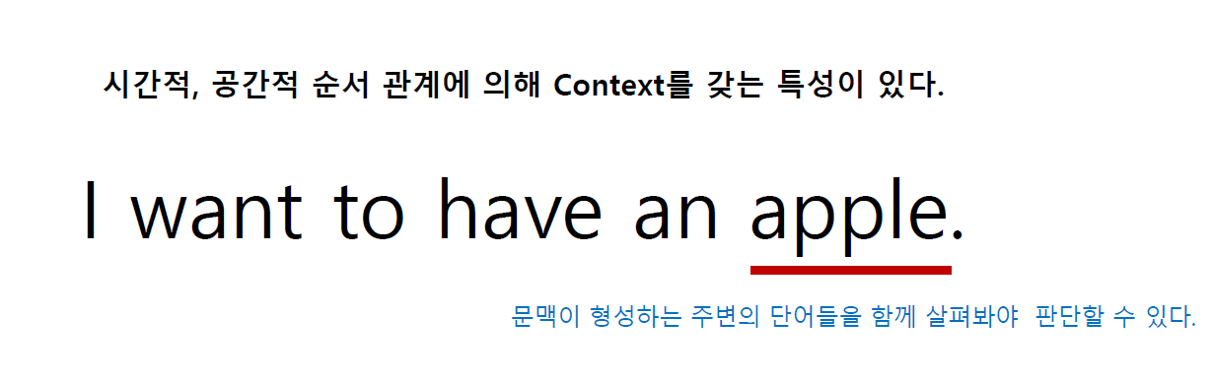
RNN

Slide 4
RNN
여기에 ???
우리가 모델이 되어서 모델링을 해보자

Slide 5
RNN
내 물건을 찾으러 여기에 ???

Slide 6
RNN
어제 내 물건을 찾으려 여기에 ???

Slide 7
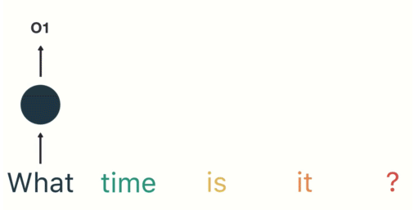
RNNs
https://towardsdatascience.com/illustrated-guide-to-recurrent-neural-networks-79e5eb8049c9

Slide 8
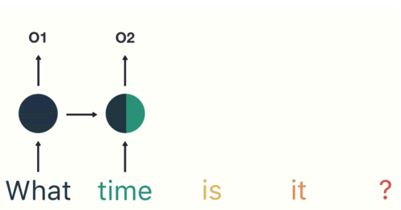
RNN
https://towardsdatascience.com/illustrated-guide-to-recurrent-neural-networks-79e5eb8049c9

Slide 9
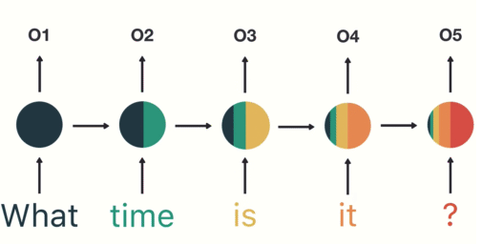
RNN
https://towardsdatascience.com/illustrated-guide-to-recurrent-neural-networks-79e5eb8049c9

Slide 10
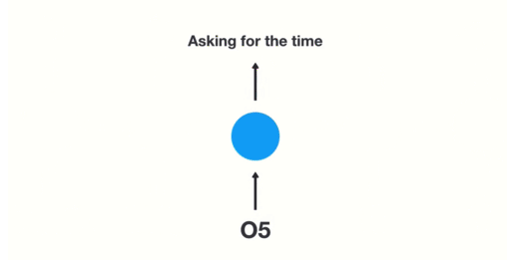
RNN
http://cs231n.stanford.edu/slides/2019/cs231n_2019_lecture10.pdf

Slide 11

Speech Recognition

Slide 12

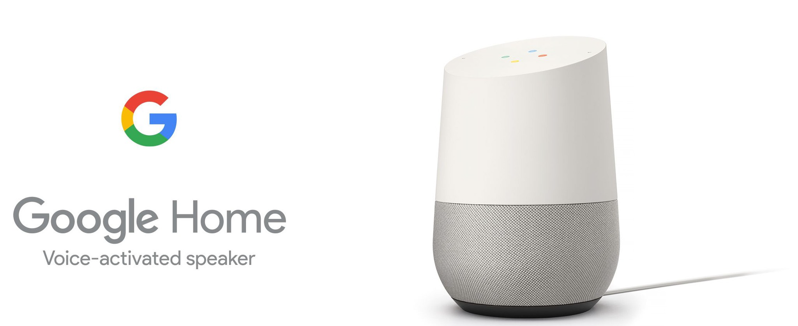
Speech Recognition

Slide 13

Machine Translation
http://blog.webcertain.com/machine-translation-technology-the-search-engine-takeover/18/02/2015/
https://www.youtube.com/watch?v=06olHmcJjS0

Slide 14
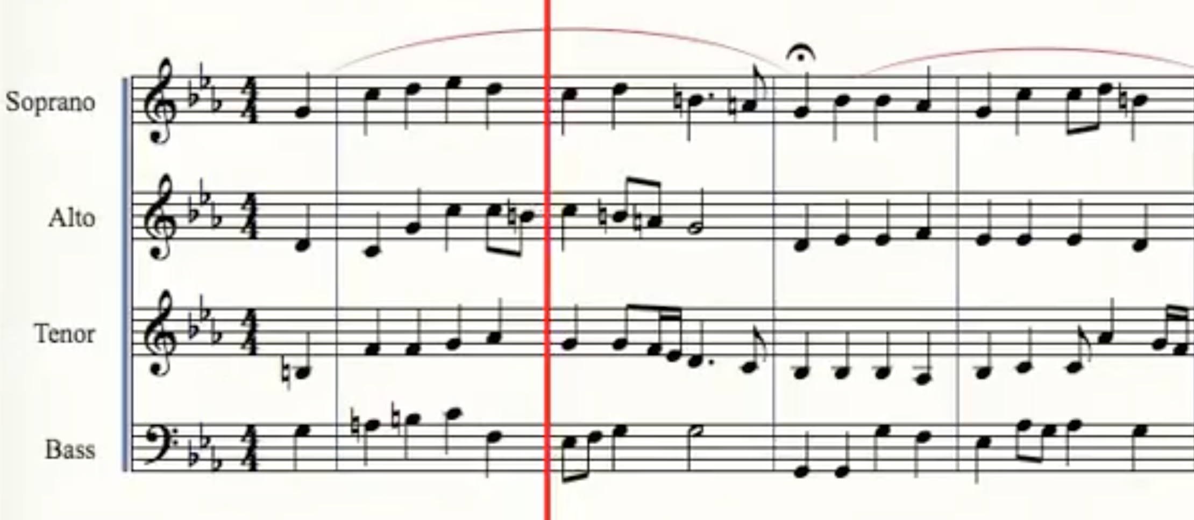
Deep Bach
https://www.youtube.com/watch?v=QiBM7-5hA6o

Slide 15
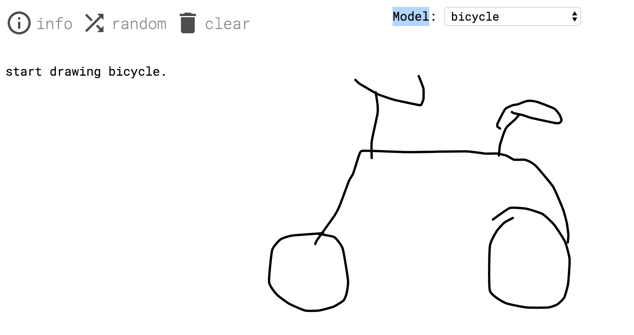
Sketch RNN
https://magenta.tensorflow.org/assets/sketch_rnn_demo/index.html

Slide 16
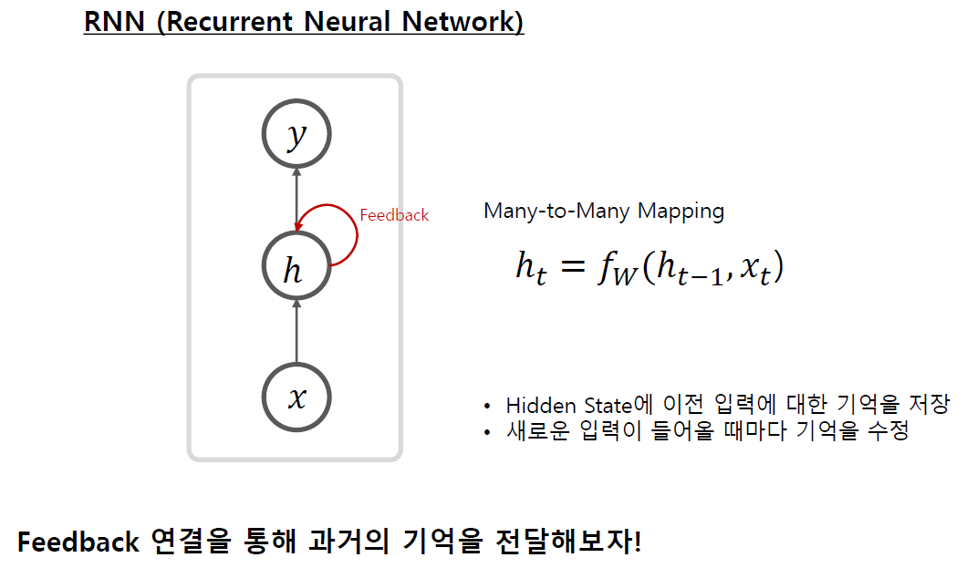
RNN

Slide 17
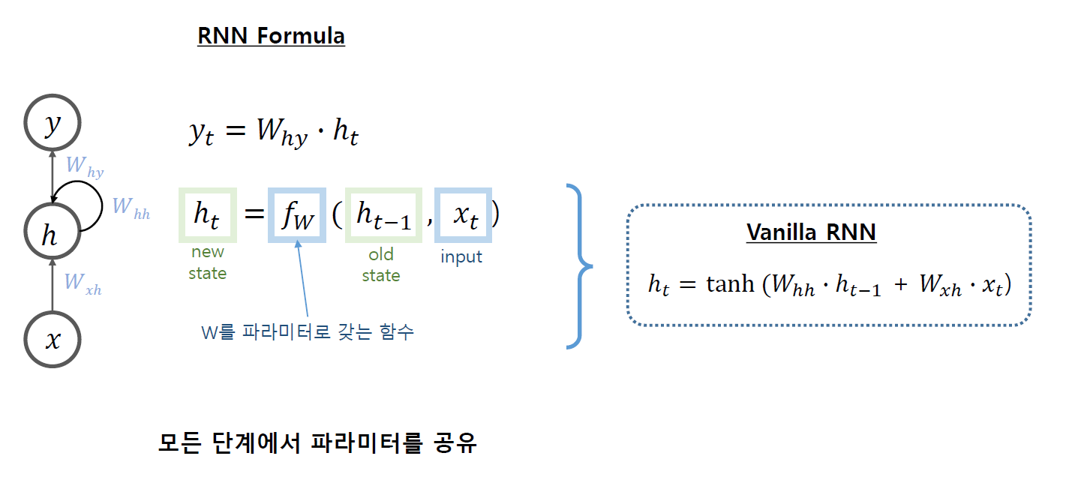
RNN

Slide 18
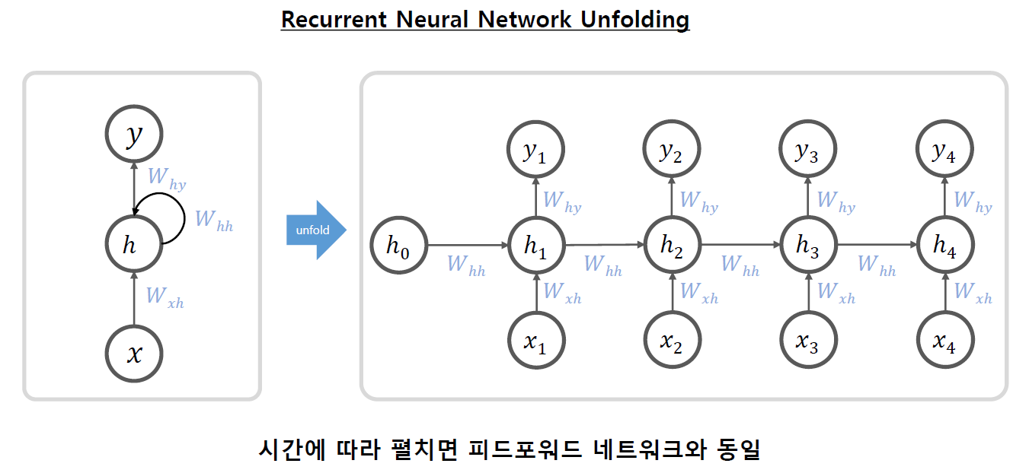
RNN

Slide 19
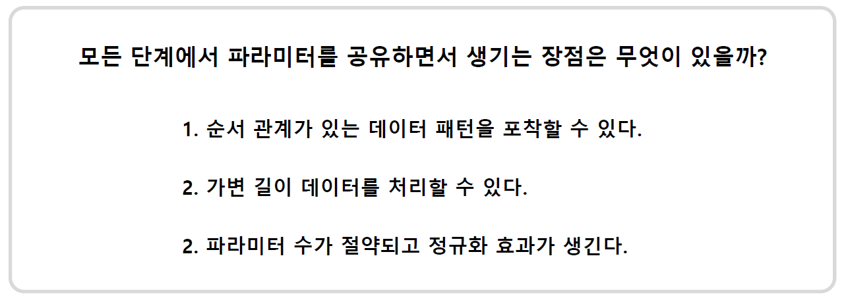
RNN

Slide 20
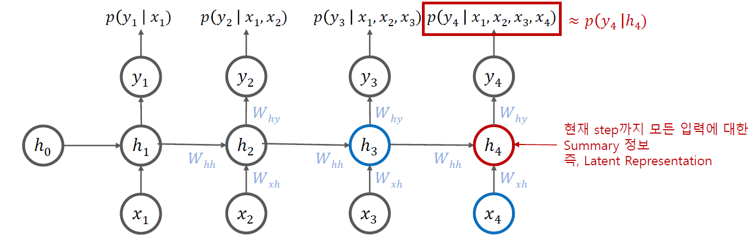
RNN

Slide 21
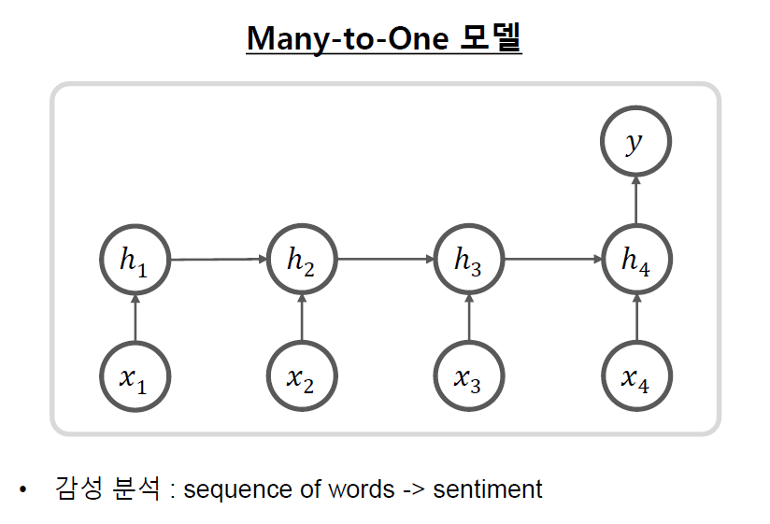
RNN - Many-to-One

Slide 22
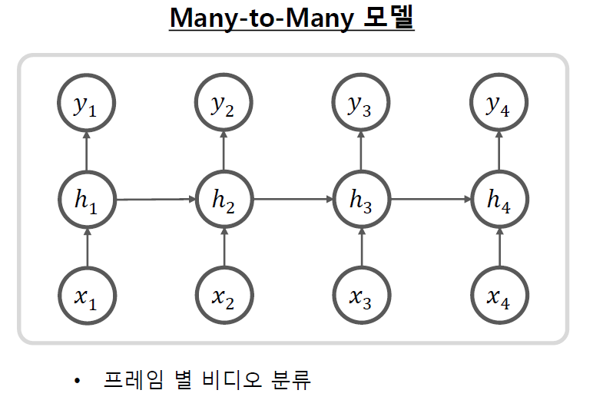
RNN - Many-to-Many

Slide 23
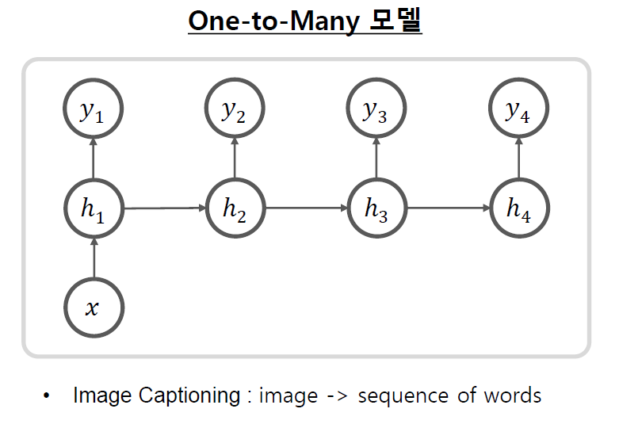
RNN - One-to-Many

Slide 24
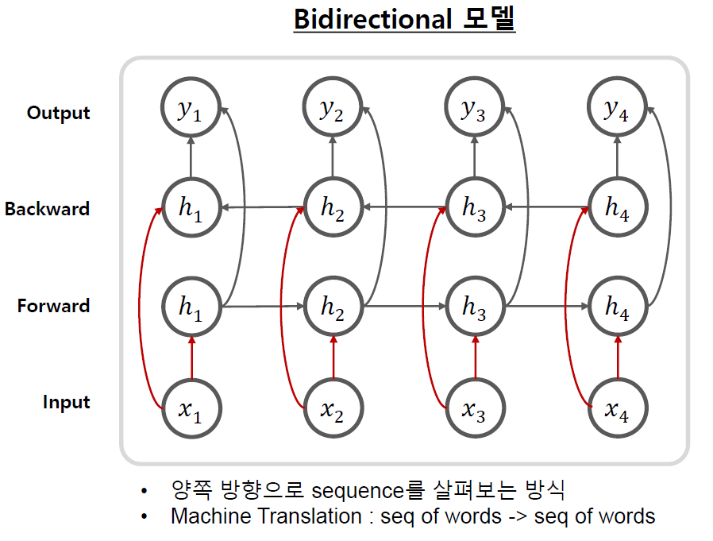
RNN - Bidirectional

Slide 25
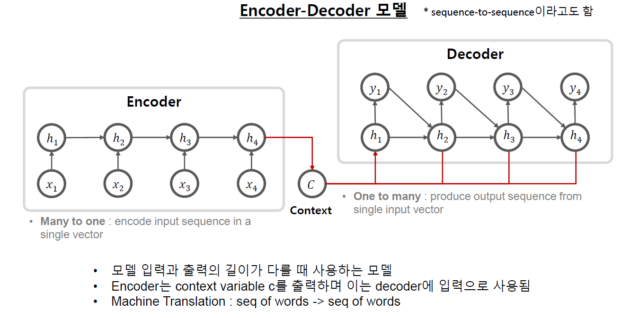
RNN - Encoder-Decoder (Seq2Seq)

Slide 26
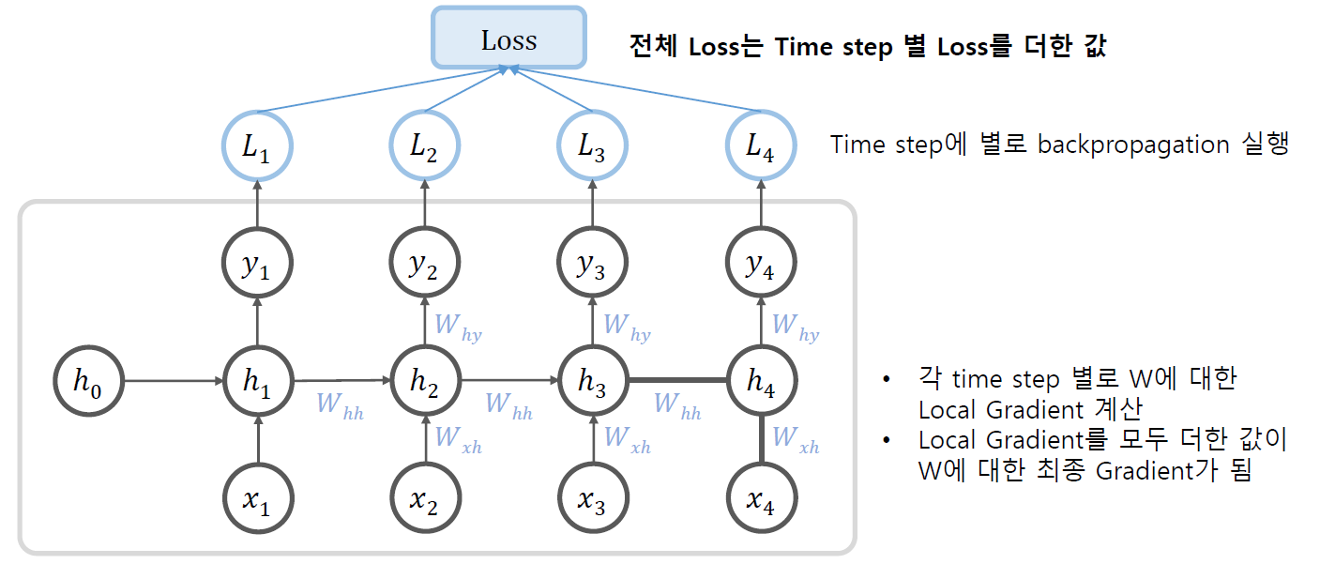
RNN - Backpropagation

Slide 27
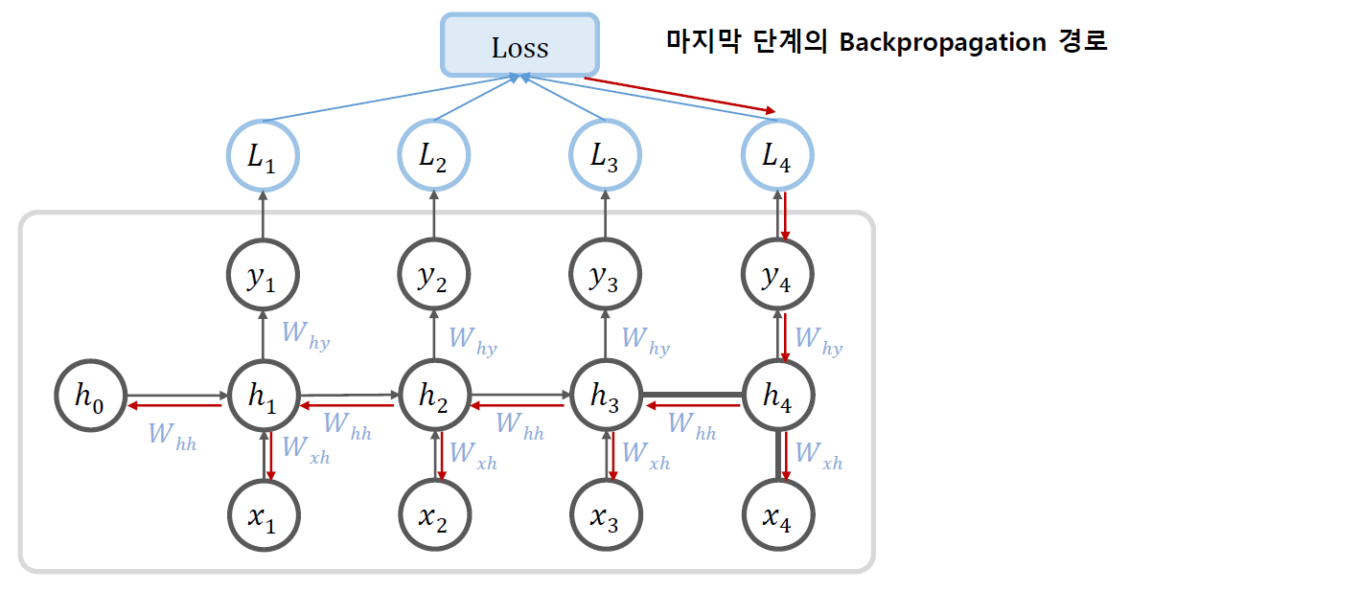
RNN - Backpropagation

Slide 28
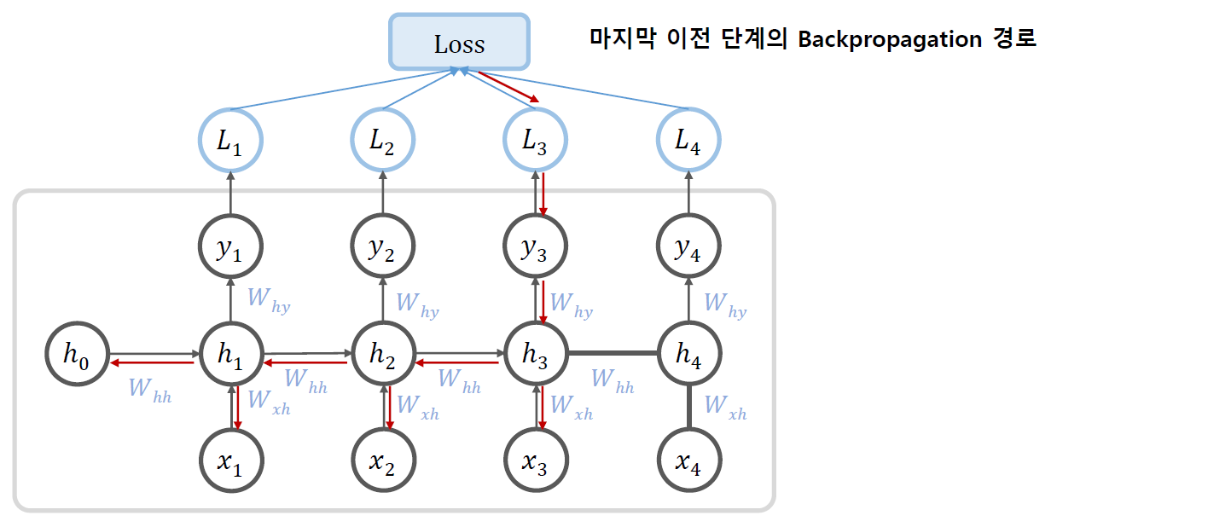
RNN - Backpropagation

Slide 29
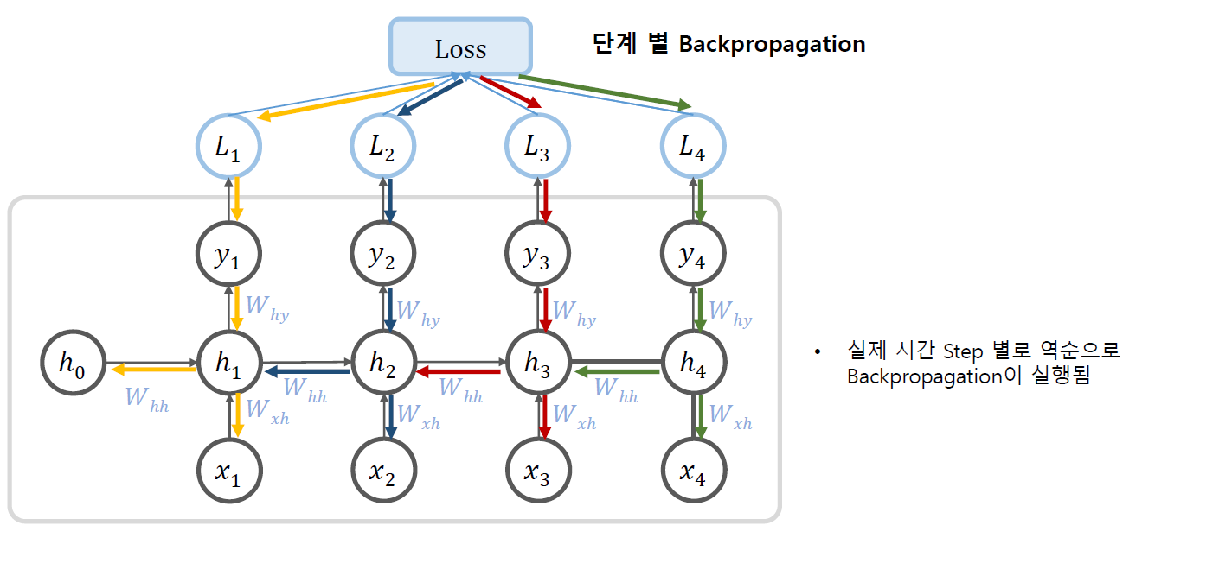
RNN - Backpropagation

Slide 30
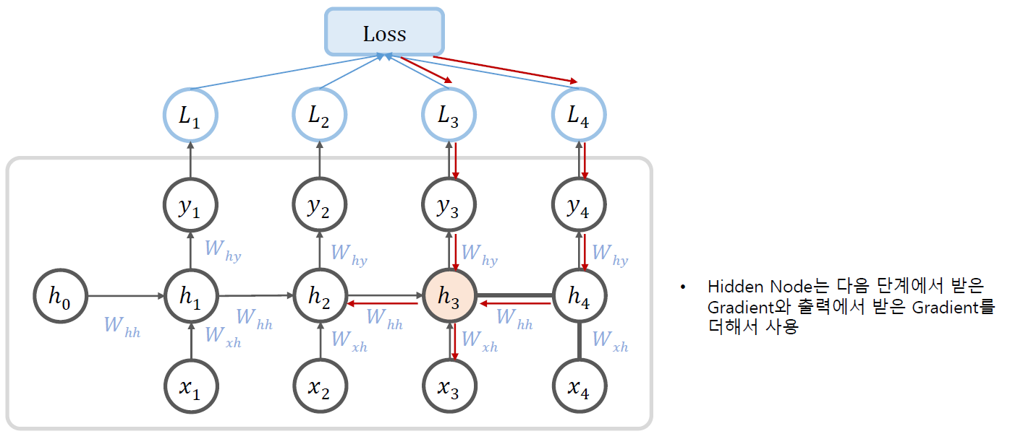
RNN - Backpropagation

Slide 31
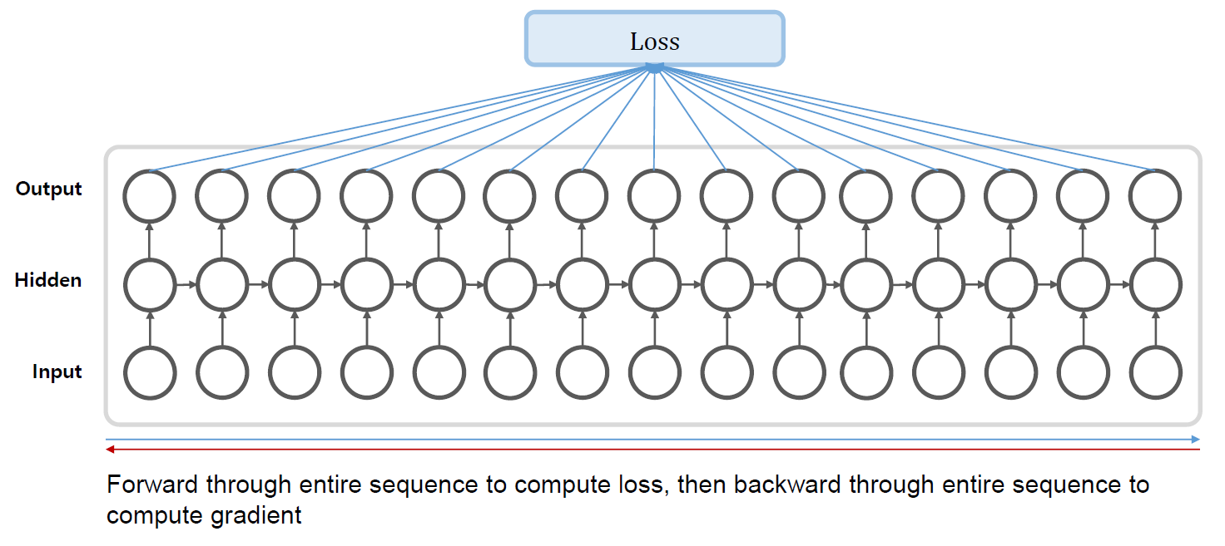
BPTT - Backpropagation Through Time

Slide 32
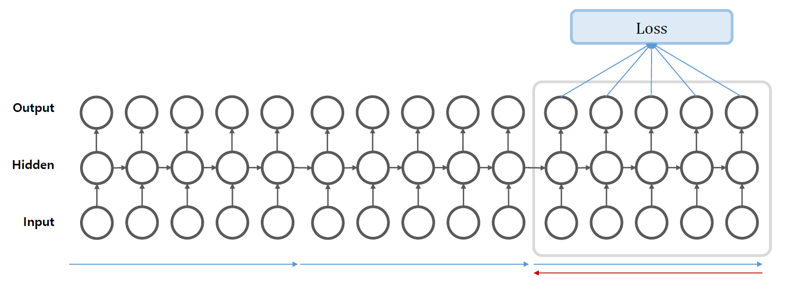
Truncated BPTT
Sequence가 긴 경우 중간을 마다 학습을 진행
(역전파만 끊어서 진행)

Slide 33
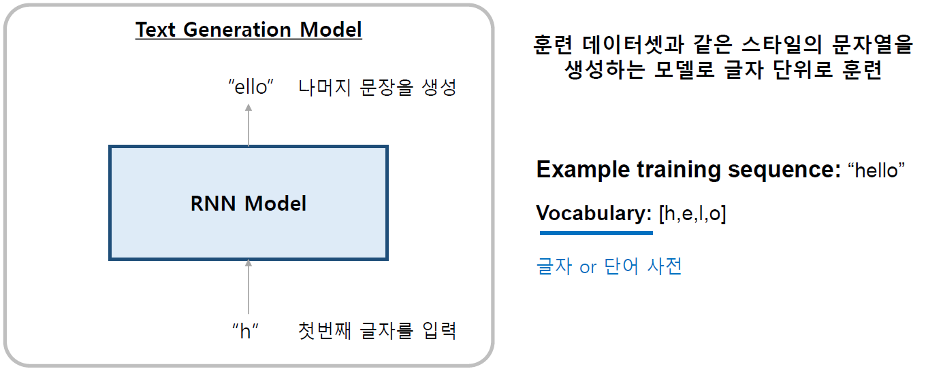
RNN example

Slide 34
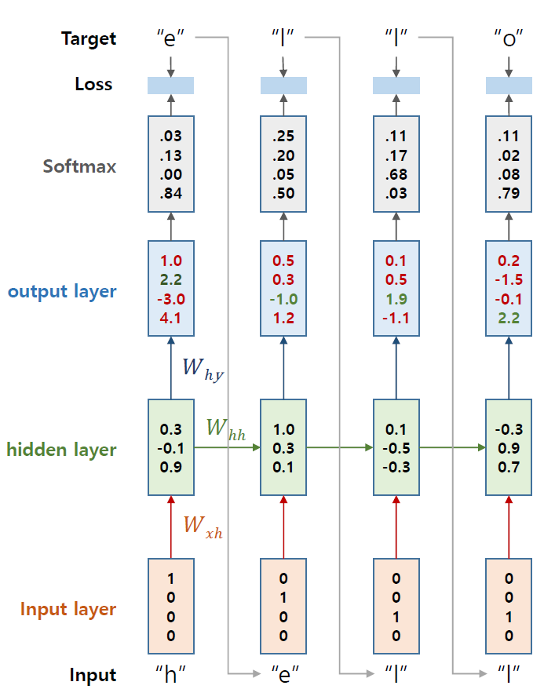
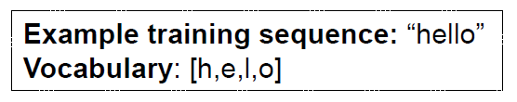
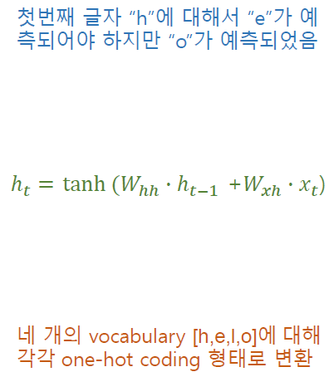
RNN Train

Slide 35
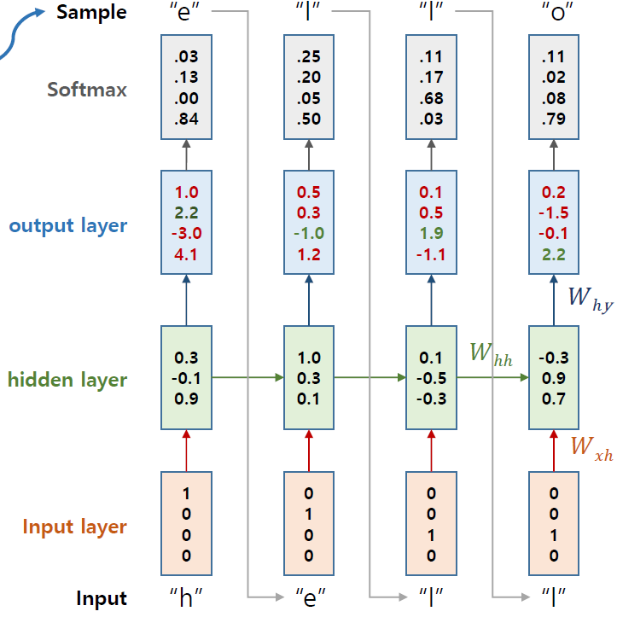
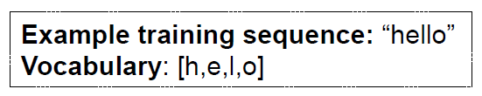
RNN Test
이번 Sequence의 예측 값을 다시 다음 Sequence의 input으로 사용

Slide 36
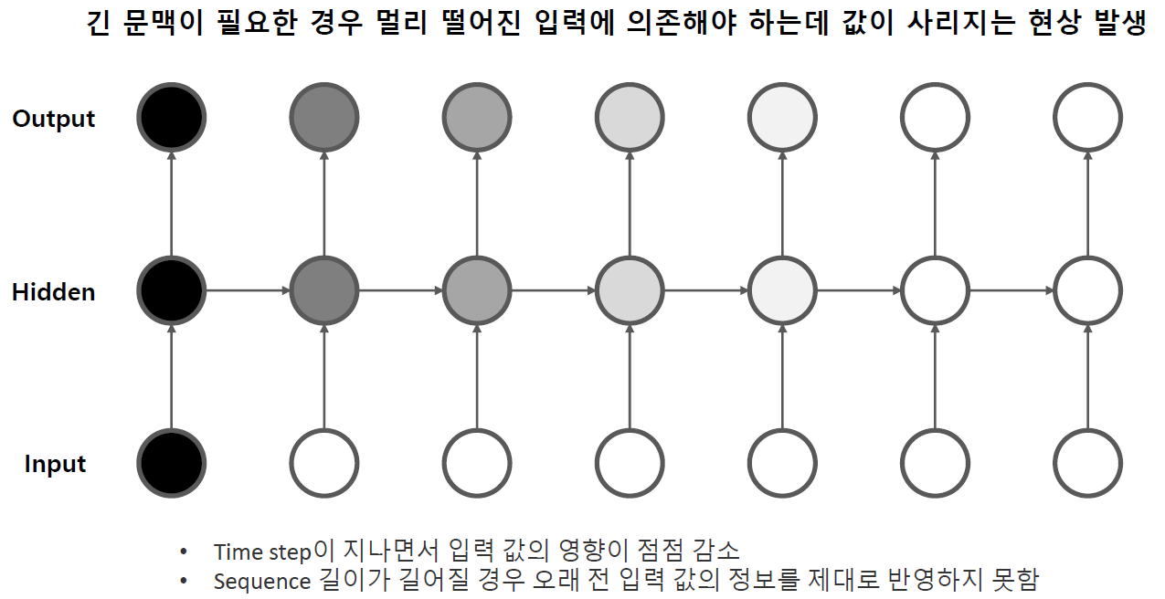
Long-Term Dependency

Slide 37
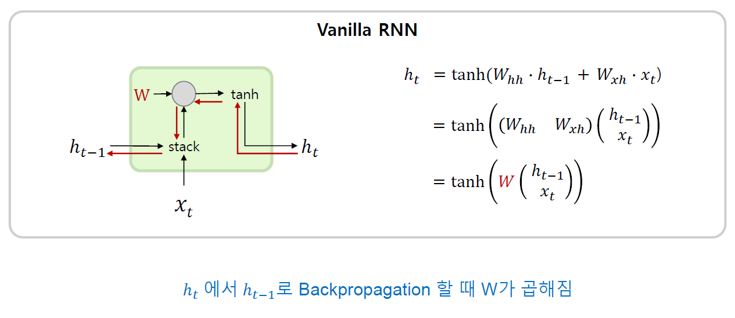
RNN Gradient Vanishing / Exploding

Slide 38
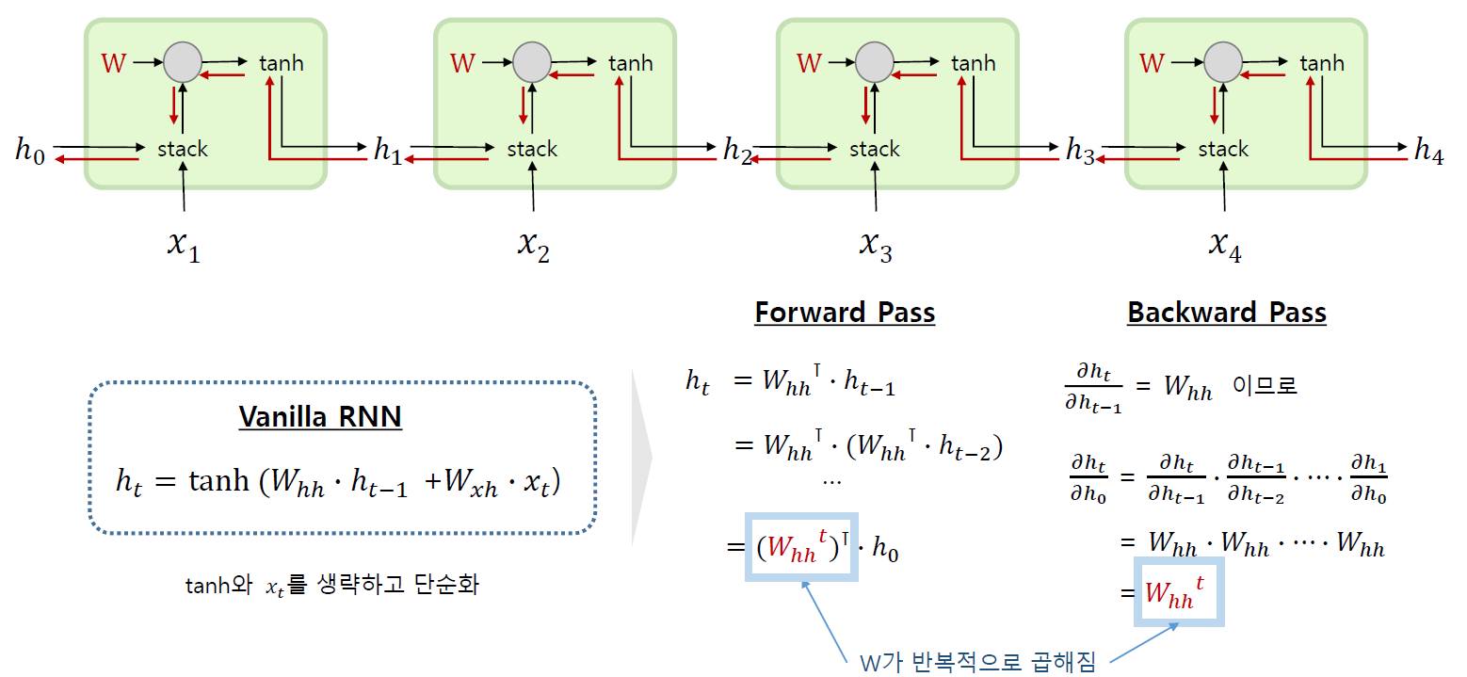
RNN Gradient Vanishing / Exploding

Slide 39
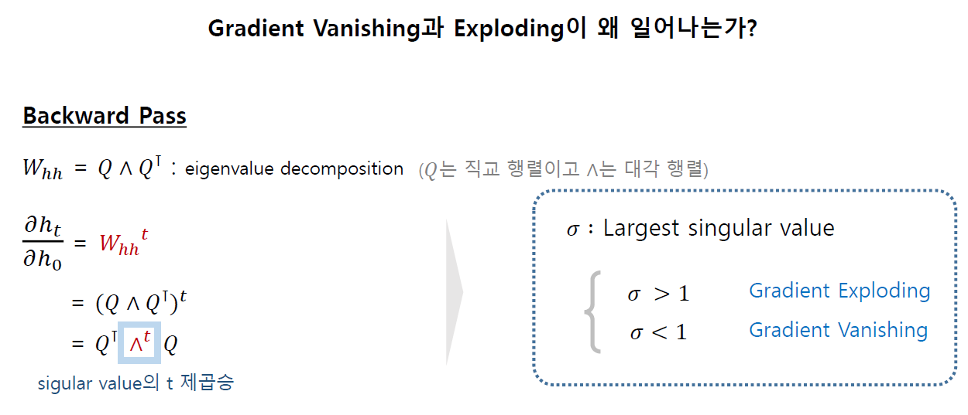
RNN Gradient Vanishing / Exploding

Slide 40
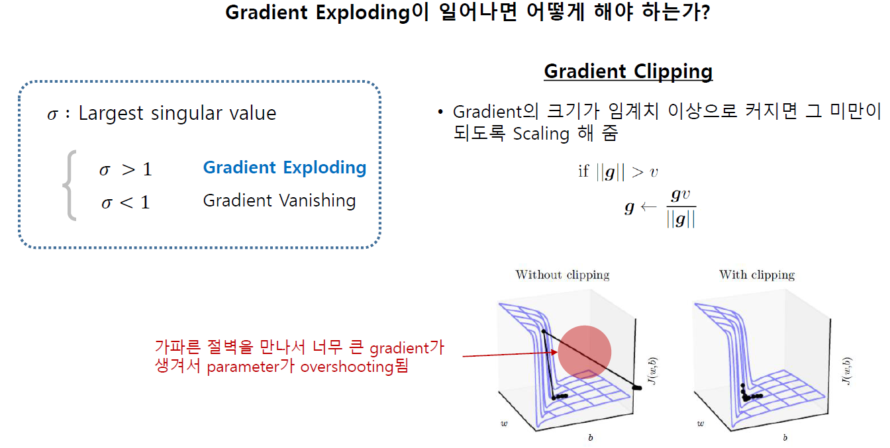
RNN Gradient Exploding

Slide 41
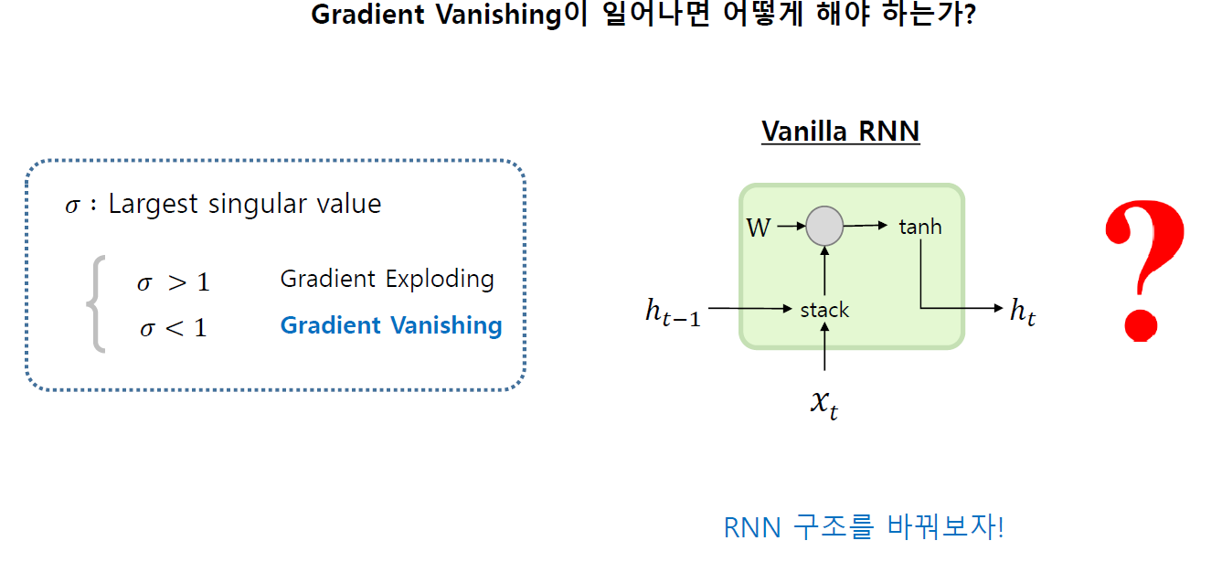
RNN Gradient Vanishing

Slide 42
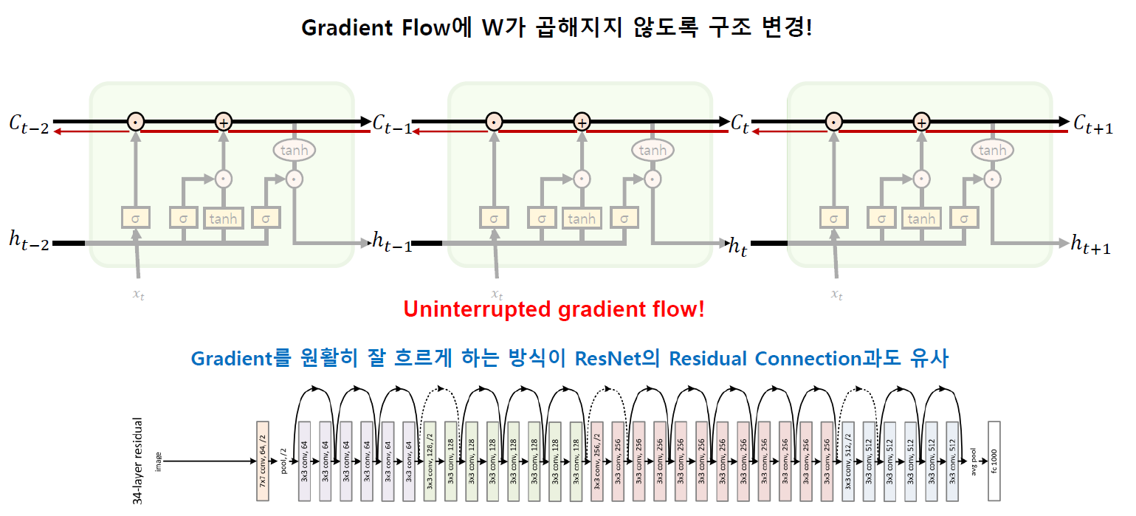
Long Short Term Memory - LSTM

Slide 43
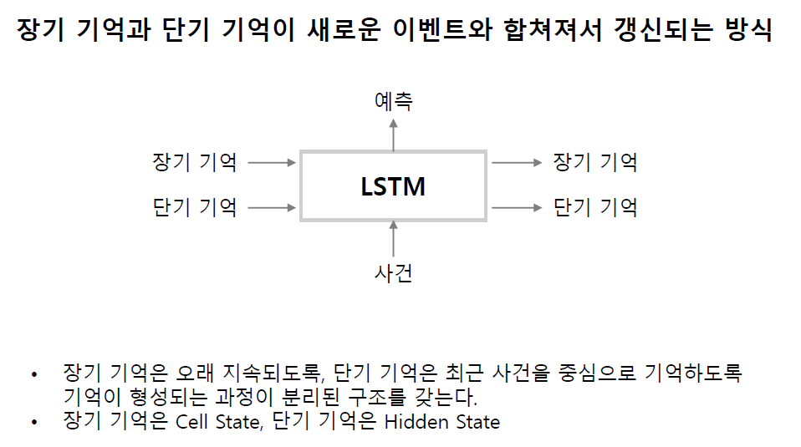
Long Short Term Memory - LSTM

Slide 44
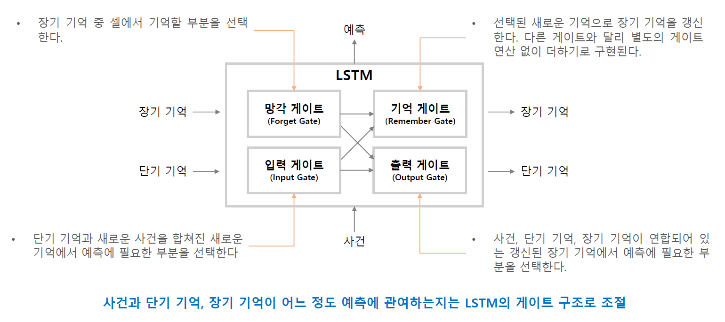
Long Short Term Memory - LSTM

Slide 45
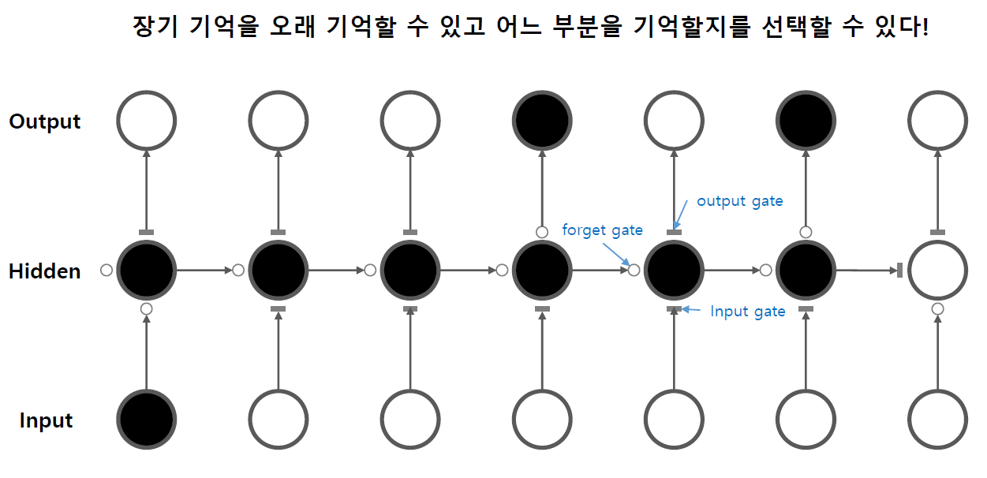
Long Short Term Memory - LSTM

Slide 46
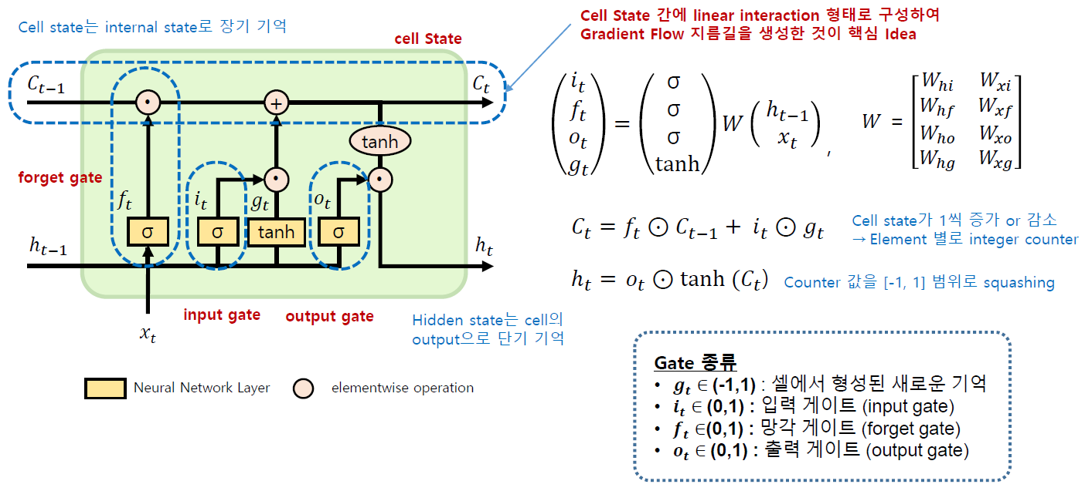
Long Short Term Memory - LSTM

Slide 47
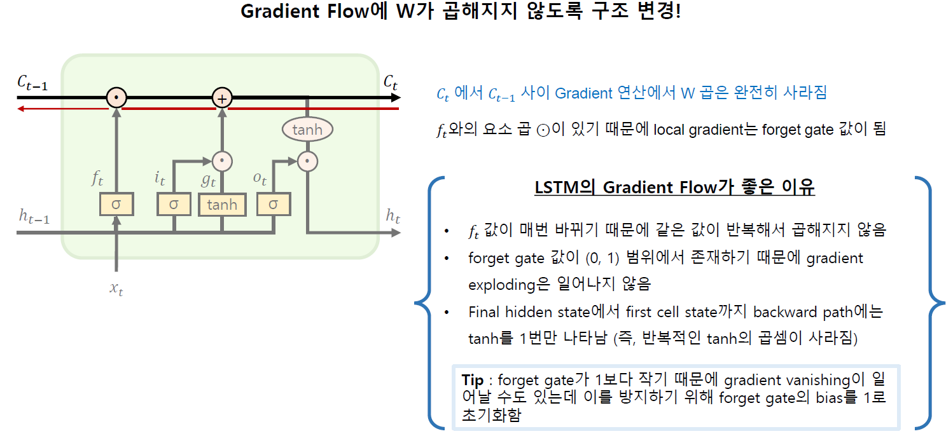
Long Short Term Memory - LSTM

Slide 48
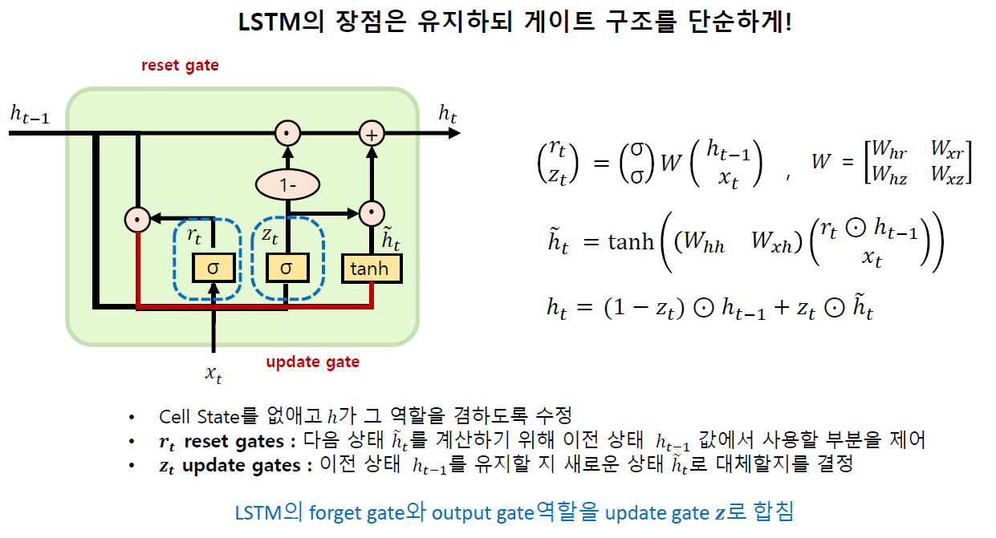
Long Short Term Memory - GRU

Slide 49
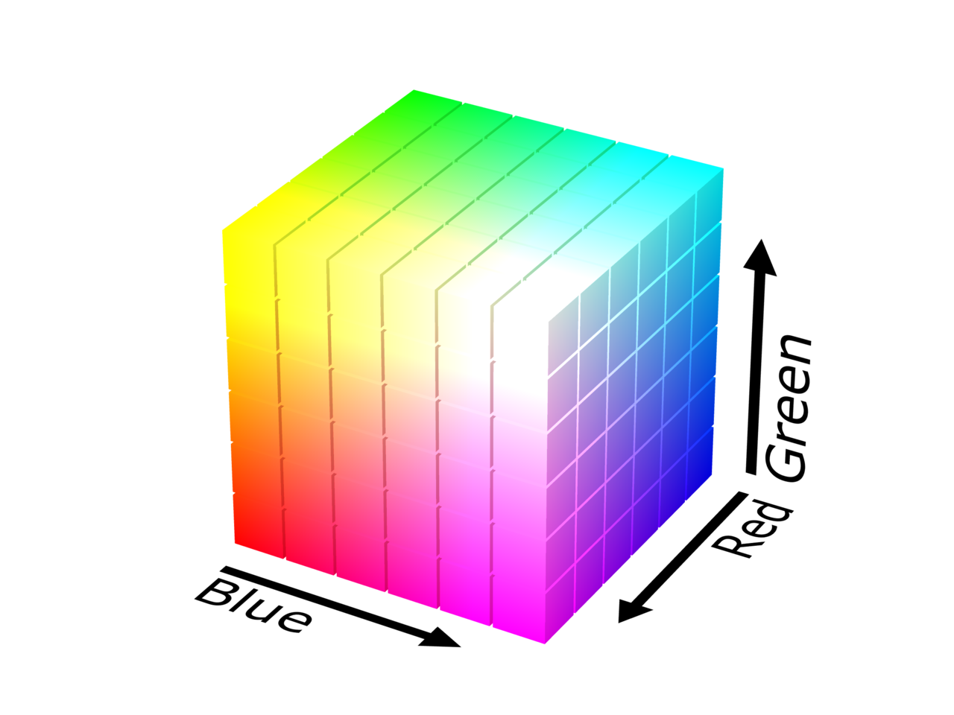
NLP - distributional hypothesis
우리가 사용하는 자연어를 연산할 수 있을까?
Color => RGB 벡터로 표현
단어도 벡터로 표현해보자!
자연어는 이미지보다 높은 차원의 데이터

Slide 50
NLP - Word2Vec
단어를 추론해보자
You say goodbye and I say hello.
이 문장을 이용해 모델을 학습시키기 위해 각 단어들을 연산이 가능한 형태로 변경해야한다.
http://colah.github.io/posts/2015-08-Understanding-LSTMs/

Slide 51
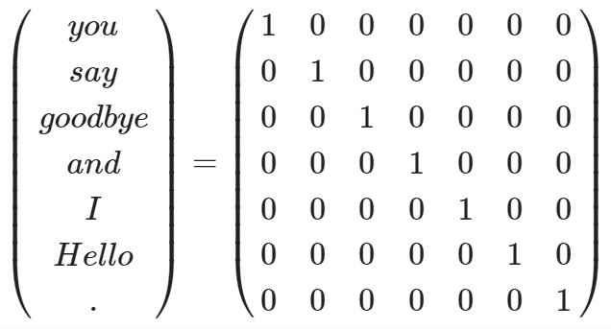
NLP - Word2Vec
단어를 One-hot 벡터로 표현
http://jalammar.github.io/illustrated-word2vec/

Slide 52
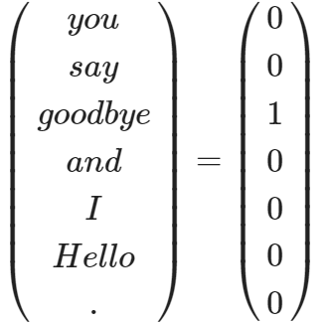
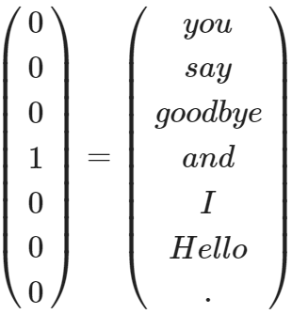
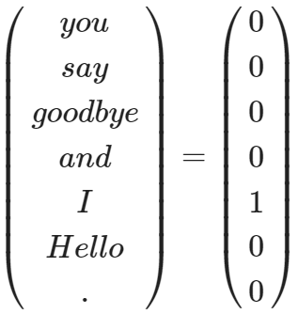
NLP - Word2Vec
Model
http://jalammar.github.io/illustrated-word2vec/

Slide 53
NLP - Word2Vec
이미지를 학습하듯 단어를 벡터로 보고 학습한다.
you
good bye
Model
and

Slide 54
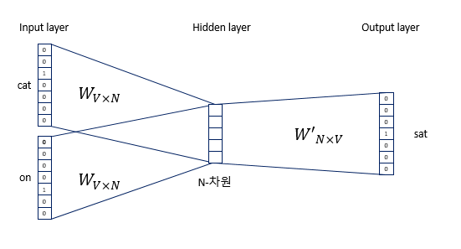
NLP - Word2Vec - CBOW
https://wikidocs.net/22660

Slide 55

NLP - Word Embedding
W
=
h
(1 x 1,000,000)
(1 x 100)
(1,000,000 x 100)
https://wikidocs.net/22660

Slide 56
NLP - Word Embedding
T
W
100개 벡터
[0.8, 1.2, -0.8, -1.5 … 2.2]
h
(1 x 100)
(1 x 7)
(7 x 100)
Embedding Size
https://wikidocs.net/22660

Slide 57

NLP - Word Embedding
Embedding 된 단어들은 학습이 가능한 파라미터
http://jalammar.github.io/illustrated-word2vec/

Slide 58

NLP - Word Embedding
http://jalammar.github.io/illustrated-word2vec/

Slide 59

Seq2seq
https://lilianweng.github.io/lil-log/2018/06/24/attention-attention.html

Slide 60

Attention Mechanism
https://www.tensorflow.org/tutorials/text/nmt_with_attention

